Slide 1


DeepAR
Probabilistic forecasting with autoregressive recurrent networks
B. Sc. Cristian Lazo Quispe
Computer Vision Scientist at Rimac
https://github.com/CristianLazoQuispe

Slide 2
Content
Introduction
Model
Conclusion
Code

Slide 3
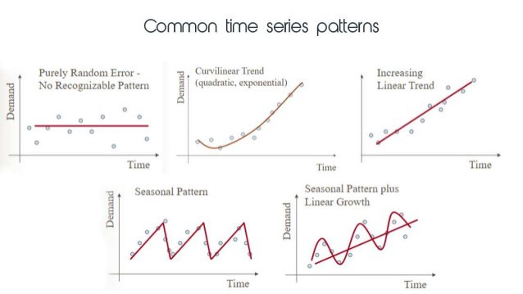
Introduction
Traditional Forecasting Methods
Intensive manual feature engineering and model selection

Slide 4
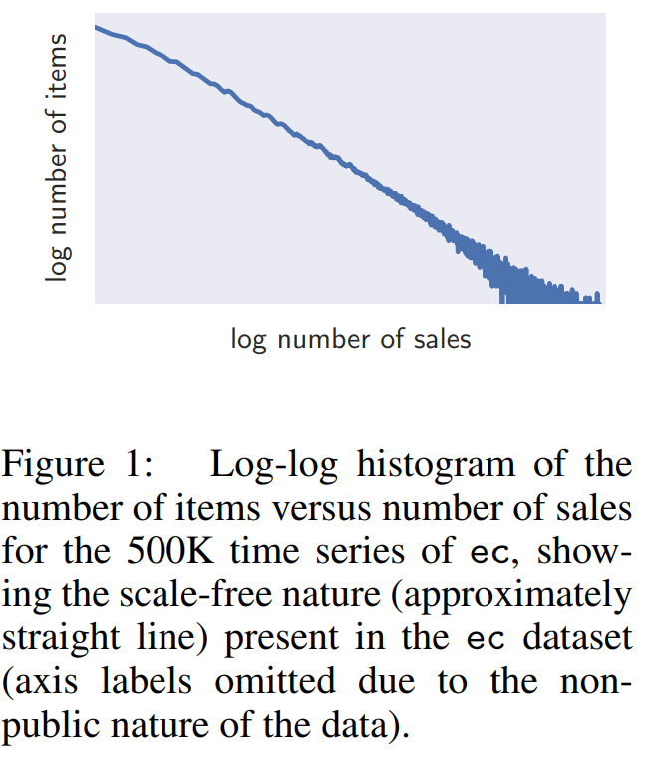
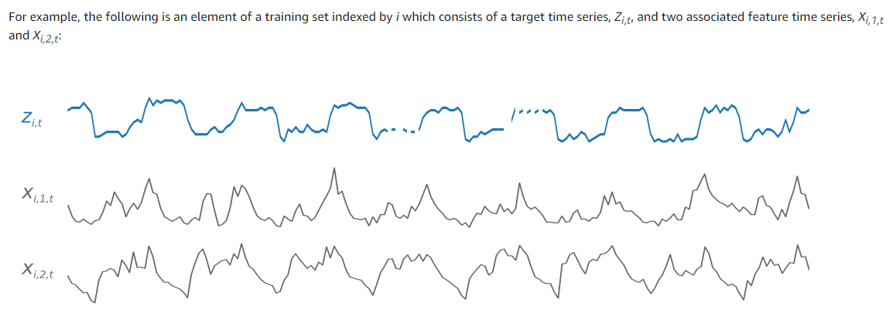
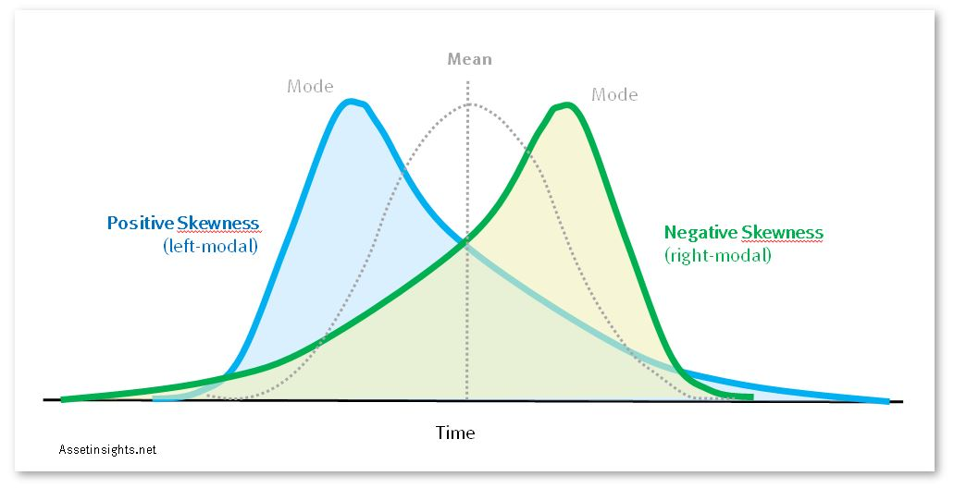
Introduction
Traditional Forecasting Methods
Limitation with the number of time series Forecasting

Slide 5
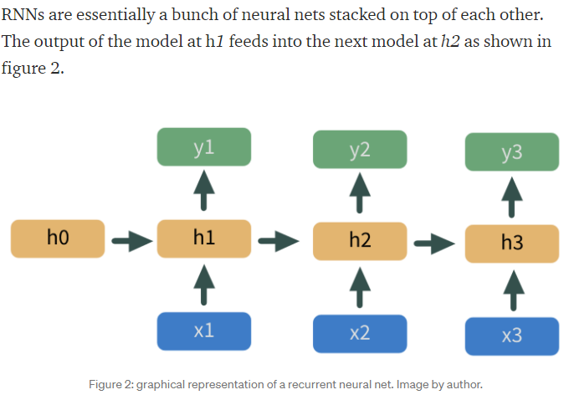
Introduction
Traditional Forecasting Methods
Typically applied to individual time series. Poor performance for items with little or not historical information

Slide 6
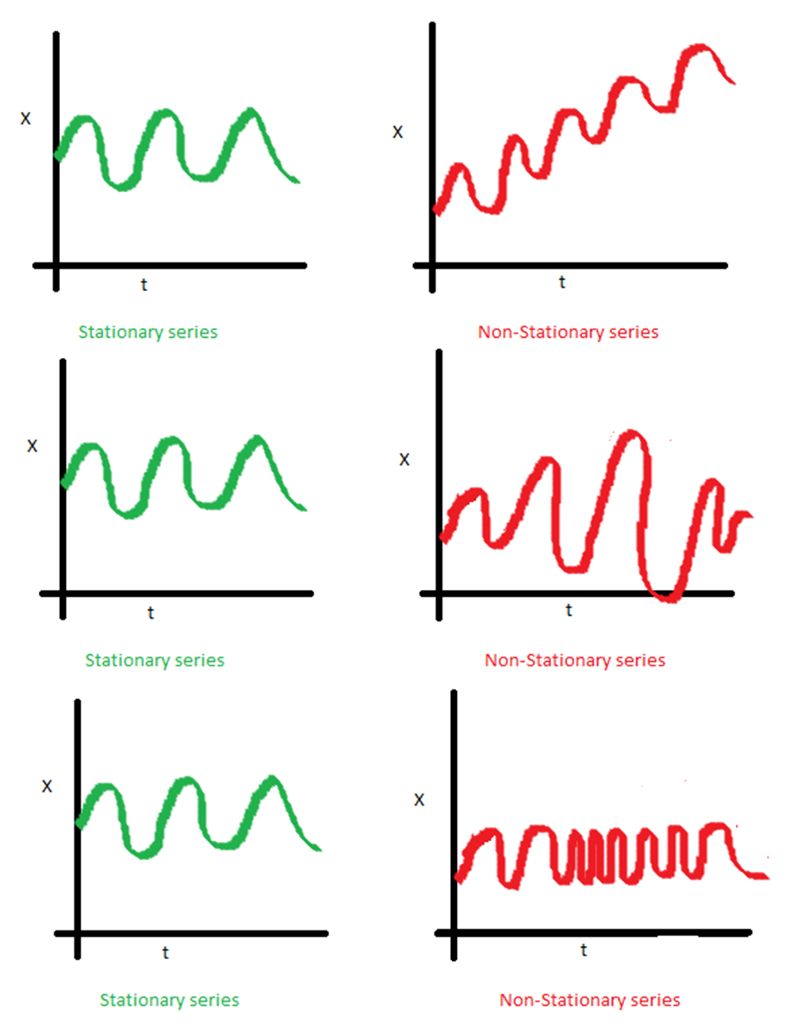
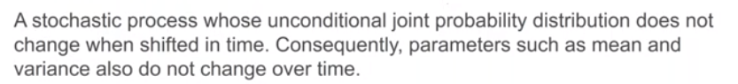
2. Model
Stationary Series

Slide 7
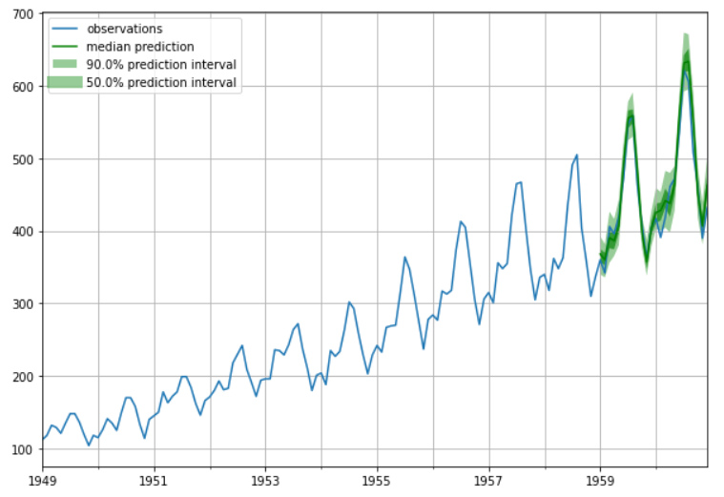
2. Model
Autoregressive model
Autoregression is a time series model that uses observations from previous time steps as input to a regression equation to predict the value at the next time step. It is a very simple idea that can result in accurate forecasts on a range of time series problems.

Slide 8
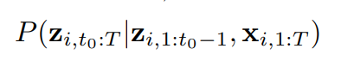
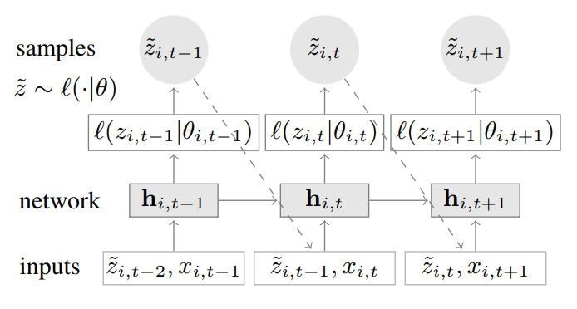

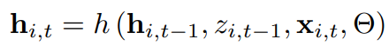
2. Model
Model
Goal: Model the conditional distribution
[1, t0 − 1] -> the conditioning range
[t0, T] -> the prediction range
Model distribution Q consists of product of likelihood factors
Multi-layer recurrent neural network with LSTM

Slide 9
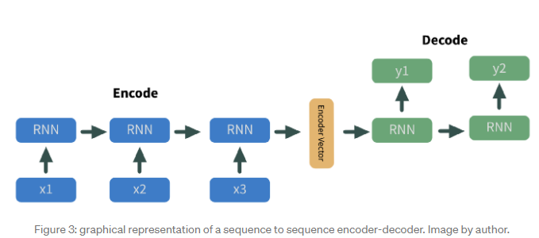
2. Model
Neural Net
This method takes a set of n inputs, encodes those inputs with a neural net, then outputs m decoded values.
Encoder and decoder model are the same in DeepAR

Slide 10
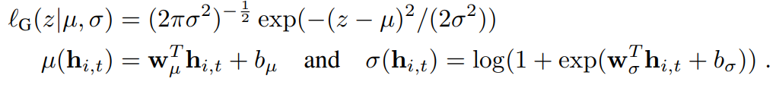
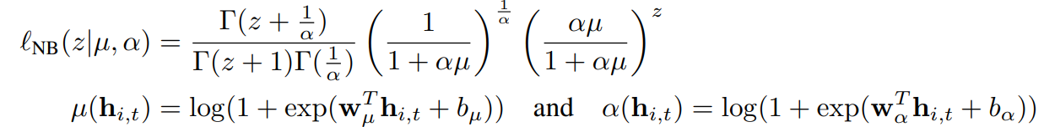
2. Model
Likelihood Model
Gaussian Likelihood for real-valued
Negative-binomial likelihood for positive count data
The network directly predict all parameters as mean and variance

Slide 11
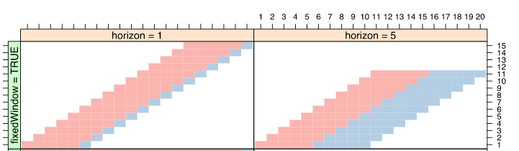
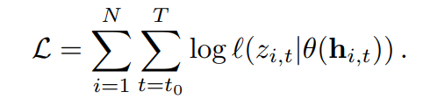
2. Model
Training
Maximizing the log likelihood (loss function)
For each time series in the dataset, we generate multiple training instances by selecting windows with different starting points from the original time series.

Slide 12

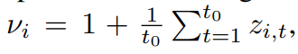
2. Model
Scale handling
Scale the input of the input layer and invert this scaling at the output.
Deal with Imbalanced data
we sample the examples non-uniformly during training. In particular, in our weighted sampling scheme, the probability of selecting a window from an example with scale Vi is proportional to Vi .

Slide 13
3. Conclusion
DeepAR has the advantage of training several hundred or thousands of time-series simultaneously, potentially offering significant model scalability. It also has the following technical benefits:
Minimal Feature Engineering: The model requires minimal feature engineering, as it learns seasonal behaviour on given covariates across time series.
Monte Carlo Sampling: It is also possible to compute consistent quantile estimates for the sub-ranges of the function, as DeepAR implements Monte Carlo sampling. This could, for instance, be useful when deciding on safety stock.
Built-in item supersession: It can predict on items with little history items by learning from similar items
Variety of likelihood functions: DeepAR does not assume Gaussian noise, and likelihood functions can be adapted to the statistical properties of the data allowing for data flexibility.

Slide 14
4. Code
https://github.com/CristianLazoQuispe/DeepAR-Tutorial

Slide 15
6. References
Traditional Forecasting Methods
DeepAR: Probabilistic Forecasting with Autoregressive Recurrent Networks https://arxiv.org/pdf/1704.04110.pdf
Amazon SageMaker’s Built-in Algorithm Webinar Series: DeepAR Forecasting. https://www.youtube.com/watch?v=g8UYGh0tlK0
How to Forecast Time Series Data Using Deep Learning https://towardsdatascience.com/deep-learning-for-time-series-data-ed410da30798
Data Splitting https://topepo.github.io/caret/data-splitting.html
Prophet vs DeepAR https://towardsdatascience.com/prophet-vs-deepar-forecasting-food-demand-2fdebfb8d282

